Slide 1
OBJECTIVE
Store wants to create an annual sales reports for 2023. So that, Owner can understand their customers and grow more sales in 2024.

Slide 2
SAMPLE QUESTIONS
Compare the sales and orders using single chart.
Which month got the highest sales and orders?
Who purchased more men or women in 2023?
What are the different orders status in 2023?
List top 5 states contributing to the sales?
Relationship between age and gender based on number of orders.
Which channel is contributing to maximum sales?
Highest selling category? Etc.

Slide 3
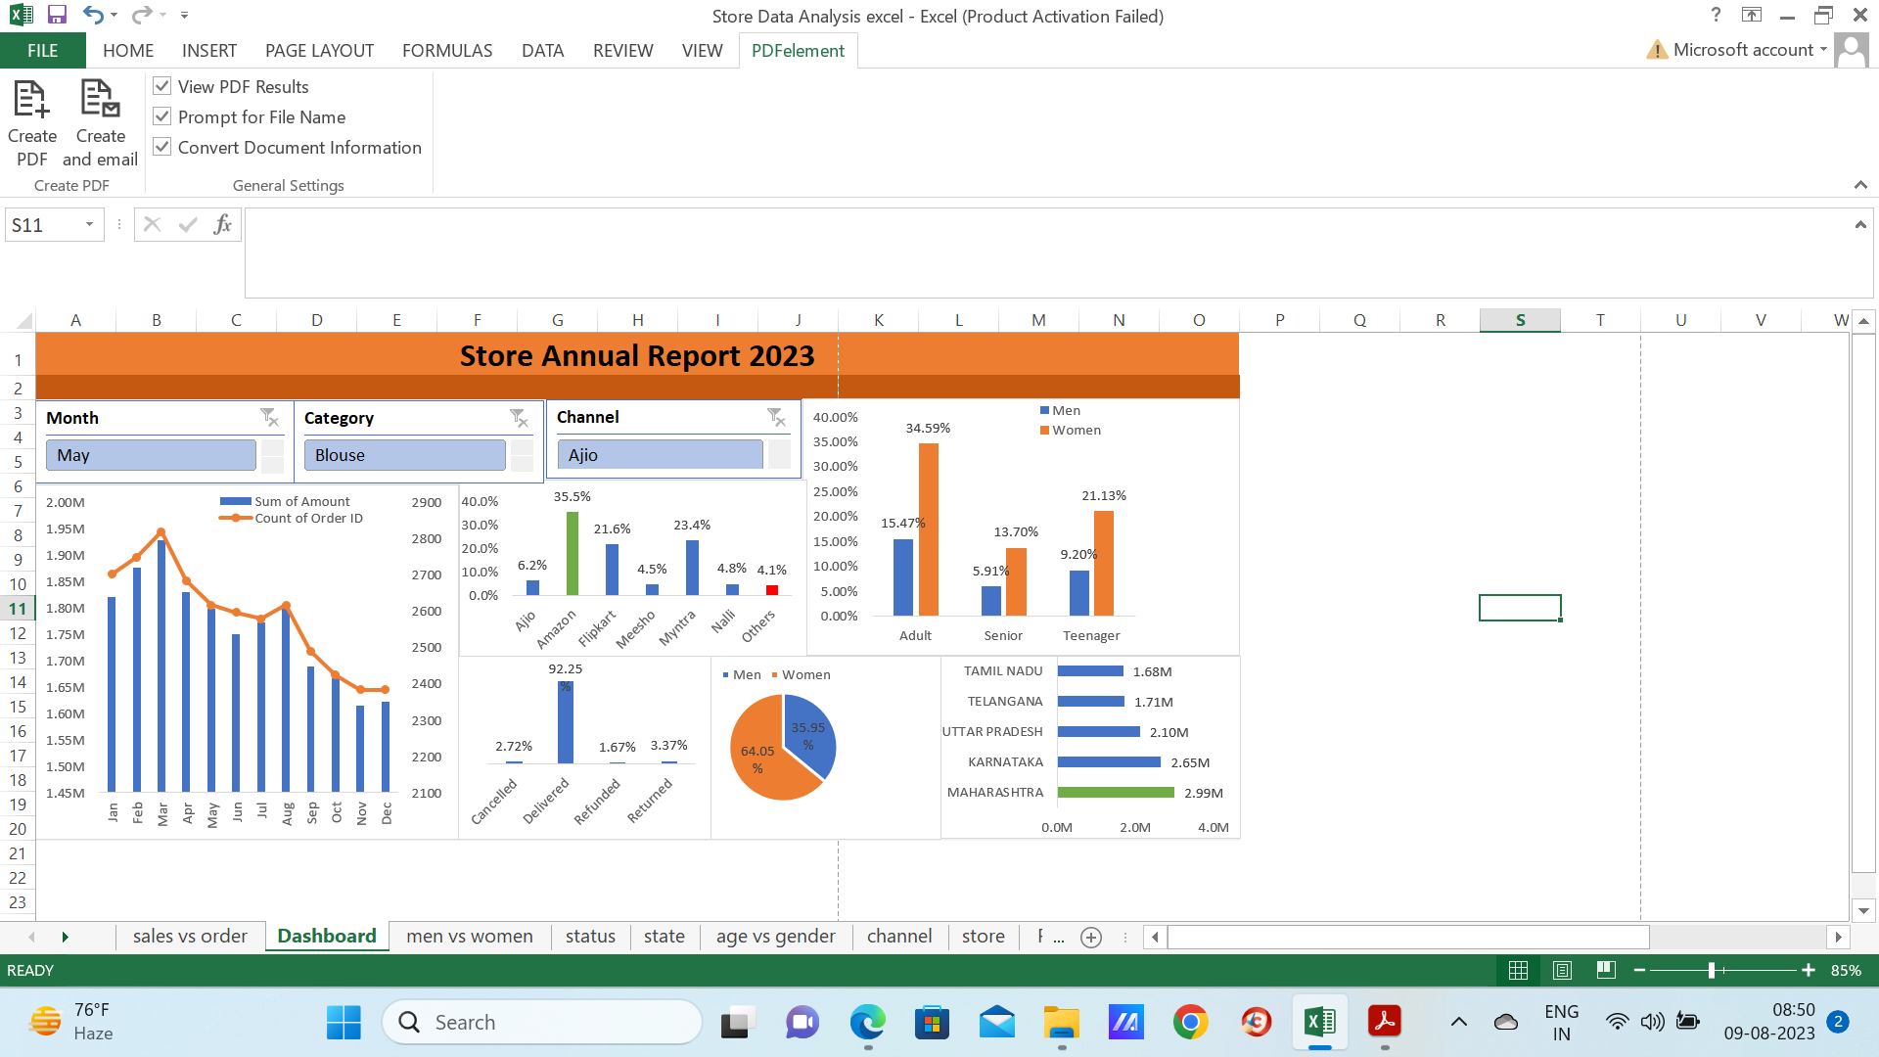
DASHBOARD

Slide 4
INSIGHTS
Women are more likely to buy compared to men(65%).
Maharashtra, Karnataka and Uttar Pradesh are the top 3 states(35%).
Adult age group(30-49 yrs) is max contribution(50%).
Amazon, Flipkart and Myntra channels are max contribution(80%).

Slide 5
Final conclusion to improve store sales:
Target women customers of age(30-49 yrs) living in Maharashtra, Karnataka and Uttar Pradesh by showing ads/offers/coupons available on Amazon, Flipkart and Myntra.

